Slide 1
Matlab Application: Numerical Integration
Week 10 Day 39

Slide 2
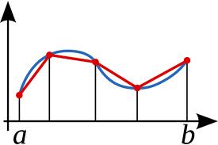
Numerical Integration
The “Trapezoidal Rule” is a method of performing a definite integral numerically.
The range between the limits of integration is broken into n segments
The function is evaluated at each of the n+1 points
The area of the resulting trapezoids is summed to approximate the area under the curve (the integral)

Slide 3
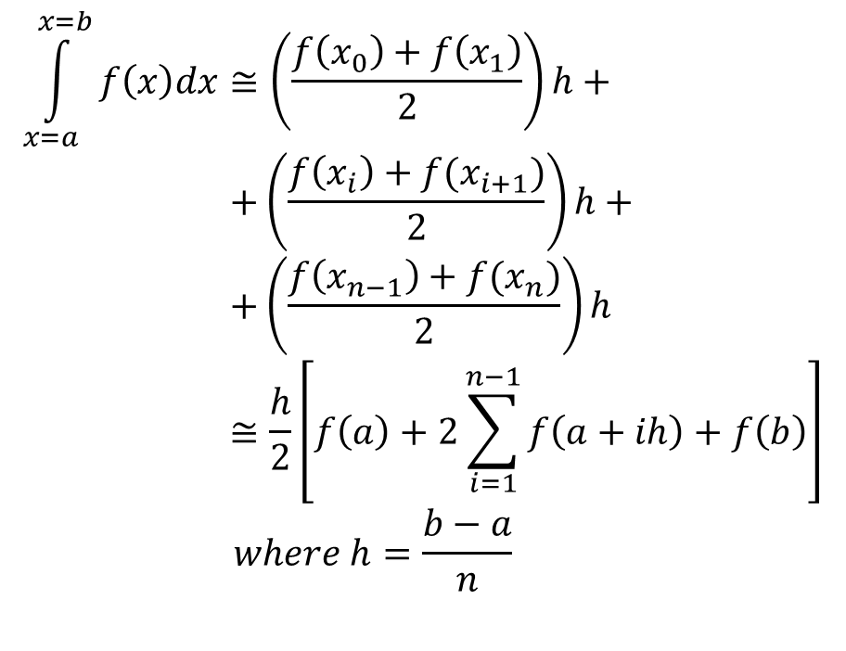
Trapezoidal Rule
$$\int_{x=a}^{x=b}{f\left(x\right)dx}≅\left(\frac{f\left(x_{0}\right)+f\left(x_{1}\right)}{2}\right)h+ \\ +\left(\frac{f\left(x_{i}\right)+f(x_{i+1})}{2}\right)h+ \\ +\left(\frac{f\left(x_{n−1}\right)+f(x_{n})}{2}\right)h \\ ≅\frac{h}{2}\left[f\left(a\right)+2\sum_{i=1}^{n−1}{f\left(a+ih\right)}+f\left(b\right)\right] \\ where h=\frac{b−a}{n}$$

Slide 4

In-Class Exercise #7
Perform a numerical integration using the trapezoidal rule:
Divide the range 0 ≤ x ≤ π into n = 6 segments/trapezoids
The exact solution is A = π/2; compute the percent error in your integral.
$$A=\int_{x=0}^{π}{\sin^{2}{x} dx}$$

